Slide 1
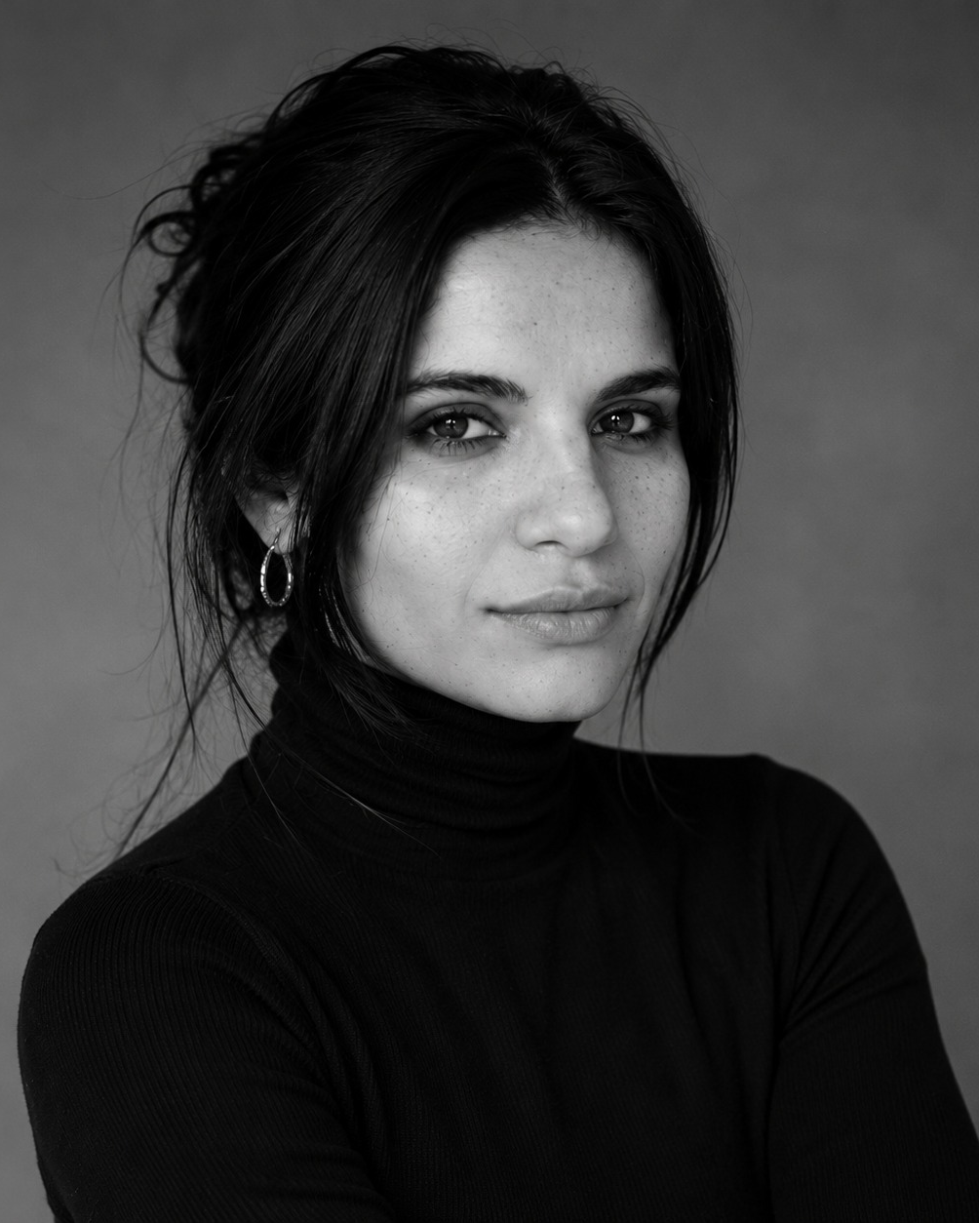
LIVE MASTERCLASS · 90 MINUTES
Hire your first
AI employee.
→ It is running before we hang up
→ Live, step by step, with me
→ No code. No jargon. No homework.
FATIHA CHIKH · SHIFT & LEAD · RUNS HER BUSINESS ON AI EMPLOYEES SHE BUILT HERSELF
SEATS LIMITED · LINK IN BIO

Slide 2

LIVE BOOTCAMP · 2 DAYS
Your business,
running on AI.
In 2 days.
→ Day 1: your AI sounds like you, inbox handled
→ Day 2: a month of content, one system live
→ Replays and every template included
FATIHA CHIKH · SHIFT & LEAD · RUNS HER BUSINESS ON AI EMPLOYEES SHE BUILT HERSELF
THE WAITLIST HEARS THE DATE FIRST · LINK IN BIO

Slide 3
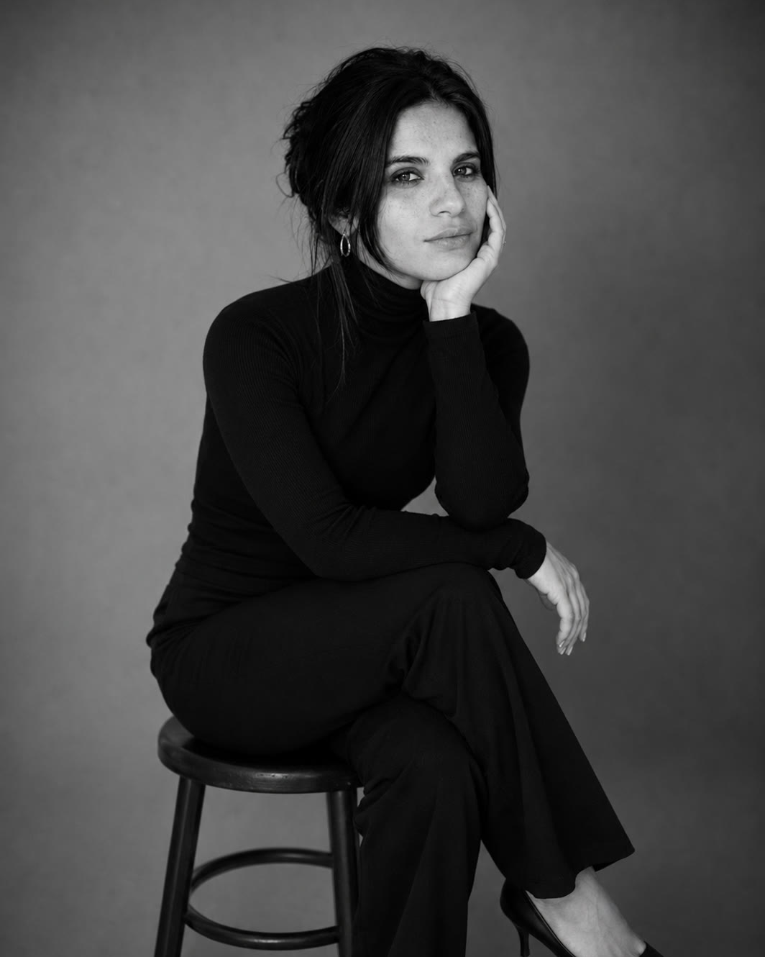
GET IT DONE DAY · MAX 10 SEATS
The Get It Done
Day.
→ Come with the half-finished automation
→ Build it with me beside you
→ It runs before dinner. Ten seats.
FATIHA CHIKH · SHIFT & LEAD · RUNS HER BUSINESS ON AI EMPLOYEES SHE BUILT HERSELF
TEN SEATS ONLY · LINK IN BIO

